Slide 1
Lab 4 Calibrating a function generator
By Daksh Khandelwal

Slide 2
Objective and Experiment
Objective - To determine the accuracy of a BK precision 4011A function generator across multiple frequency ranges.
Experiment - generate 1 khz and 5 khz sine waves.
Compare two measurement techniques:
The tektronix oscilloscope's built-in, real-time FFT.
An offline fft calculated in python using the oscilloscope's raw time-domain data.

Slide 3

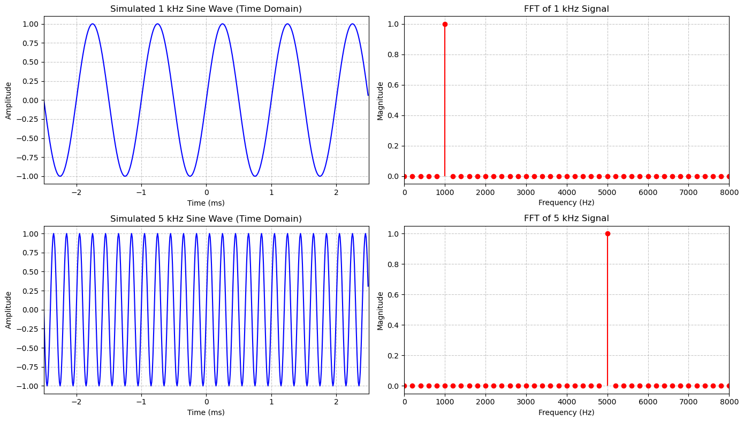

Slide 4

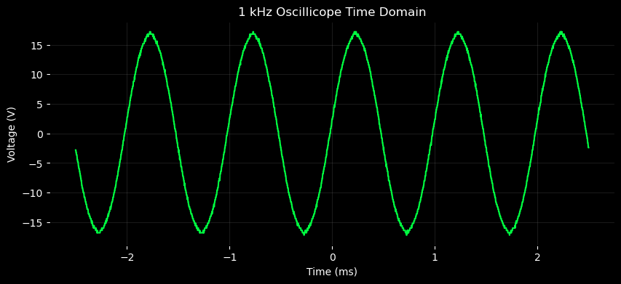
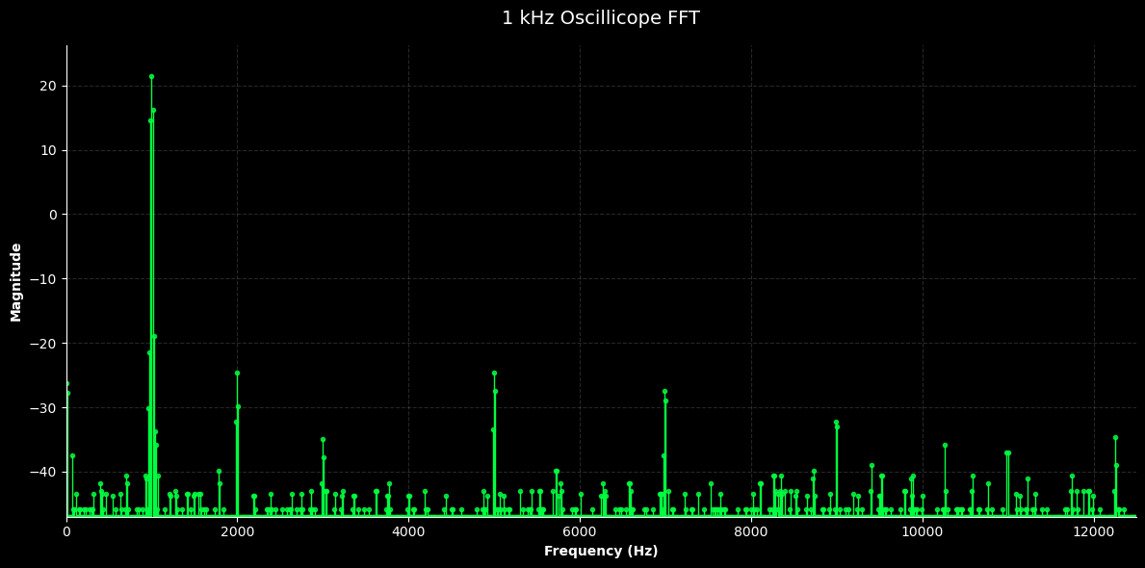
Oscillicope Data
The raw data from the oscilloscope measures harmonics for the 1 kHz sinewave.

Slide 5
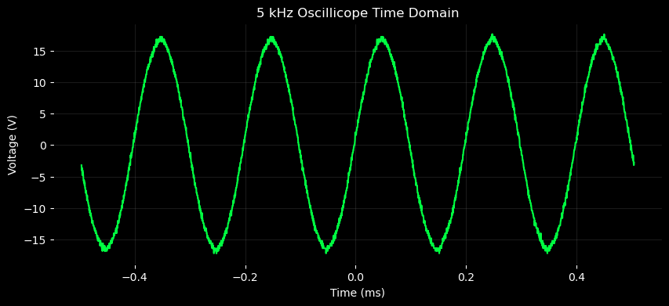

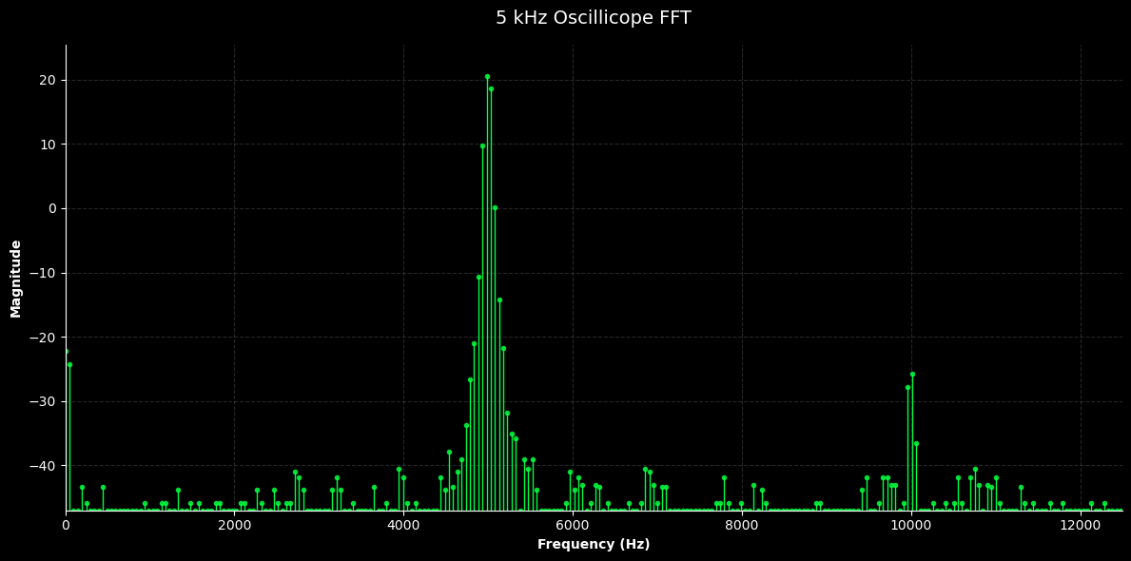
Oscillicope Data
The raw data from the oscilloscope measures harmonics for the 5 kHz sinewave.

Slide 6
Uncertainty

Slide 8
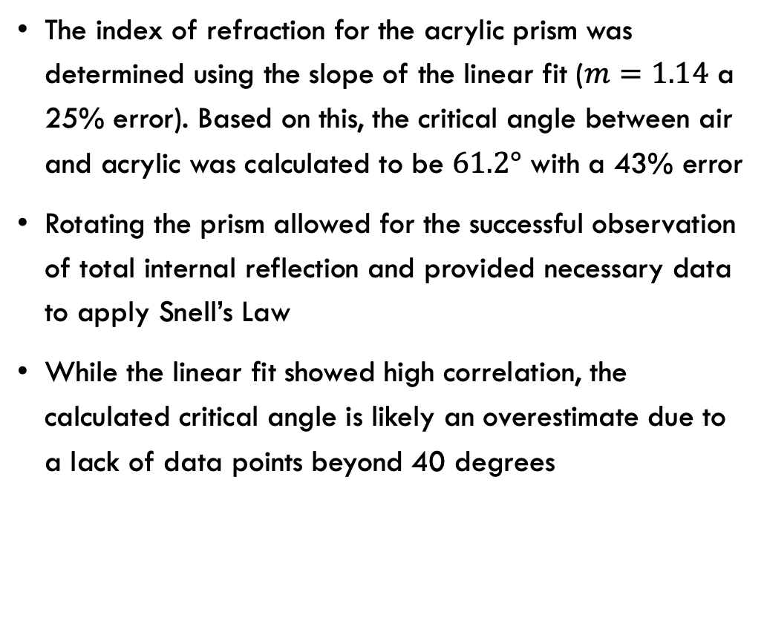
Conclusion
The index of refraction for the acrylic prism was determined using the slope of the linear fit ($m=1.14$ a 25% error). Based on this, the critical angle between air and acrylic was calculated to be $61.2°$ with a 43% error
Rotating the prism allowed for the successful observation of total internal reflection and provided necessary data to apply Snell’s Law
While the linear fit showed high correlation, the calculated critical angle is likely an overestimate due to a lack of data points beyond 40 degrees

